Slide 1
MSDM 5003 Lecture 10 6 November 2025 Boltzmann Machines and RBM
Outline:
Markov random fields (MRF)
Boltzmann machines
Restricted Boltzmann machines (RBM)
Application of RBM to recommender system

Slide 2
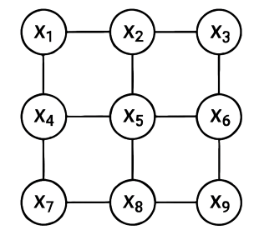
1. Markov Random Fields
Consider an undirected graphical model with a set of random variables (0 or 1) defined on the nodes. It satisfies the following Markov properties:
The key idea of Markov properties is conditional independence:
A variable is conditionally independent of all others given its neighbors.
This means that to understand a variable, you only need to look at its immediate connections—not the entire system.
Two Markov properties:
Local Markov Property: Each variable depends only on its neighbors.
Pairwise Markov Property: Non-connected nodes are conditionally independent given the rest.
Applications: e.g. image processing

Slide 3
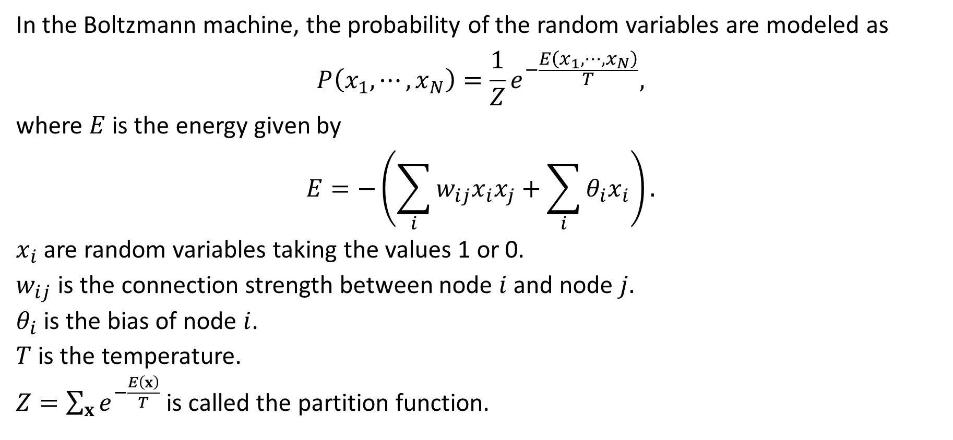
2. Boltzmann Machine¹
In the Boltzmann machine, the probability of the random variables are modeled as
$$P\left(x_{1},⋯,x_{N}\right)=\frac{1}{Z}e^{−\frac{E\left(x_{1},⋯,x_{N}\right)}{T}},$$
where $E$ is the energy given by
$$E=−\left(\sum_{i}{w_{ij}x_{i}x_{j}+\sum_{i}{θ_{i}x_{i}}}\right).$$
$x_{i}$ are random variables taking the values 1 or 0.
$w_{ij}$ is the connection strength between node $i$ and node $j.$
$θ_{i}$ is the bias of node $i$.
$T$ is the temperature.
$Z=\sum_{x}{e^{−\frac{E\left(x\right)}{T}}}$ is called the partition function.
¹Hinton, Geoffrey E. (2007-05-24). "Boltzmann machine". Scholarpedia. 2 (5): 1668.

Slide 4
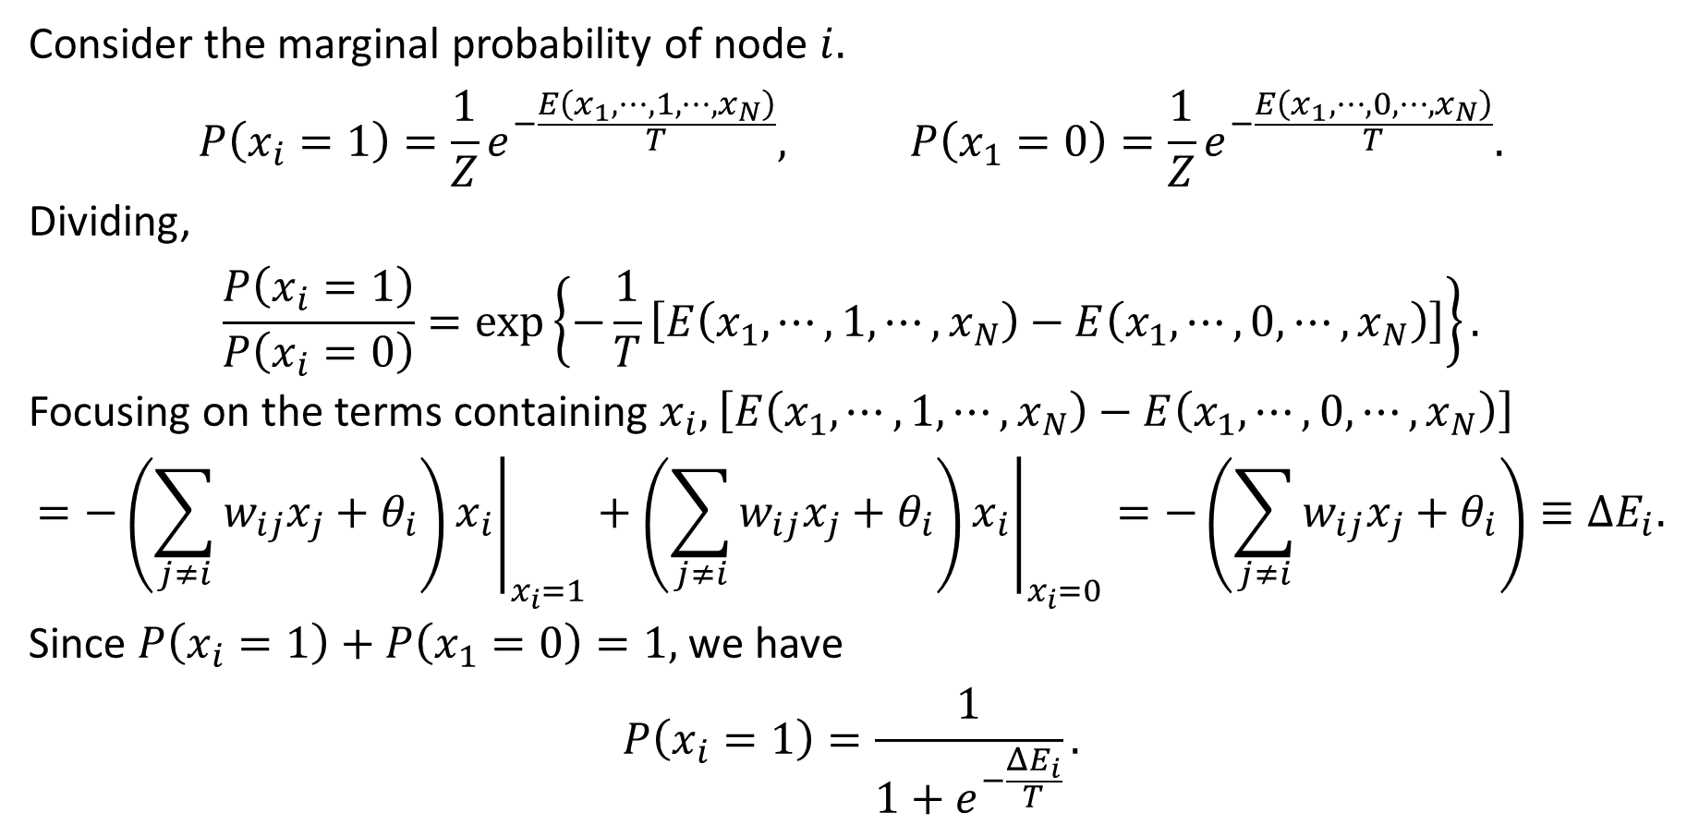
Marginal Probability
Consider the marginal probability of node $i.$
$$P\left(x_{i}=1\right)=\frac{1}{Z}e^{−\frac{E\left(x_{1},⋯, 1,⋯,x_{N}\right)}{T}}, P\left(x_{1}=0\right)=\frac{1}{Z}e^{−\frac{E\left(x_{1},⋯, 0,⋯,x_{N}\right)}{T}}.$$
Dividing,
$$\frac{P\left(x_{i}=1\right)}{P\left(x_{i}=0\right)}=\exp\left\{−\frac{1}{T}\left[E\left(x_{1},⋯, 1,⋯,x_{N}\right)−E\left(x_{1},⋯, 0,⋯,x_{N}\right)\right]\right\}.$$
Focusing on the terms containing $x_{i},$ $\left[E\left(x_{1},⋯, 1,⋯,x_{N}\right)−E\left(x_{1},⋯, 0,⋯,x_{N}\right)\right]$
$$=−{\left.\left(\sum_{j≠i}{w_{ij}x_{j}+θ_{i}}\right)x_{i}\right|}_{x_{i}=1}+{\left.\left(\sum_{j≠i}{w_{ij}x_{j}+θ_{i}}\right)x_{i}\right|}_{x_{i}=0}=−\left(\sum_{j≠i}{w_{ij}x_{j}+θ_{i}}\right)≡ΔE_{i}.$$
Since $P\left(x_{i}=1\right)+P\left(x_{1}=0\right)=1,$ we have
$$P\left(x_{i}=1\right)=\frac{1}{1+e^{−\frac{ΔE_{i}}{T}}}.$$

Slide 5
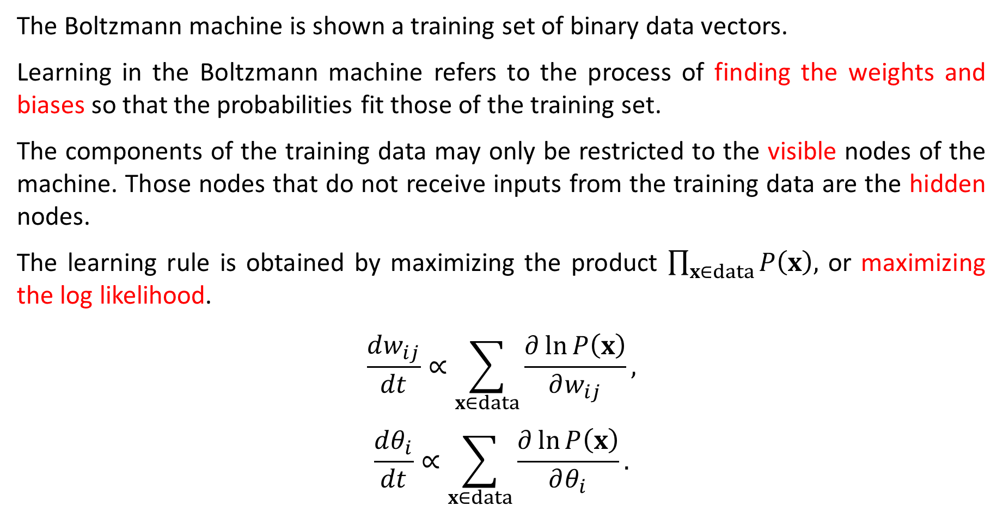
Learning in Boltzmann Machines
The Boltzmann machine is shown a training set of binary data vectors.
Learning in the Boltzmann machine refers to the process of finding the weights and biases so that the probabilities fit those of the training set.
The components of the training data may only be restricted to the visible nodes of the machine. Those nodes that do not receive inputs from the training data are the hidden nodes.
The learning rule is obtained by maximizing the product $\prod_{x∈data}{P\left(x\right),}$ or maximizing the log likelihood.
$$\frac{dw_{ij}}{dt}∝\sum_{x∈data}{\frac{∂\ln{P\left(x\right)}}{∂w_{ij}}},$$
$$\frac{dθ_{i}}{dt}∝\sum_{x∈data}{\frac{∂\ln{P\left(x\right)}}{∂θ_{i}}}.$$

Slide 6
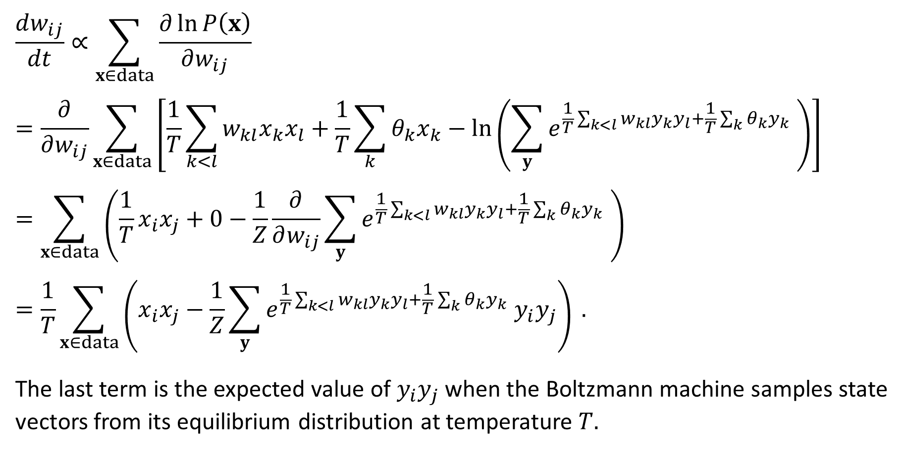
Learning Rule
$$\frac{dw_{ij}}{dt}∝\sum_{x∈data}{\frac{∂\ln{P\left(x\right)}}{∂w_{ij}}}$$
$$=\frac{∂}{∂w_{ij}}\sum_{x∈data}{\left[\frac{1}{T}\sum_{k<l}{w_{kl}x_{k}x_{l}}+\frac{1}{T}\sum_{k}{θ_{k}x_{k}}−\ln\left(\sum_{y}{e^{\frac{1}{T}\sum_{k<l}{w_{kl}y_{k}y_{l}}+\frac{1}{T}\sum_{k}{θ_{k}y_{k}}} }\right)\right]}$$
$$=\sum_{x∈data}{\left(\frac{1}{T}x_{i}x_{j}+0−\frac{1}{Z}\frac{∂}{∂w_{ij}}\sum_{y}{e^{\frac{1}{T}\sum_{k<l}{w_{kl}y_{k}y_{l}}+\frac{1}{T}\sum_{k}{θ_{k}y_{k}}} }\right) }$$
$$=\frac{1}{T}\sum_{x∈data}{\left(x_{i}x_{j}−\frac{1}{Z}\sum_{y}{e^{\frac{1}{T}\sum_{k<l}{w_{kl}y_{k}y_{l}}+\frac{1}{T}\sum_{k}{θ_{k}y_{k}}} y_{i}y_{j}}\right) }.$$
The last term is the expected value of $y_{i}y_{j}$ when the Boltzmann machine samples state vectors from its equilibrium distribution at temperature $T.$

Slide 7
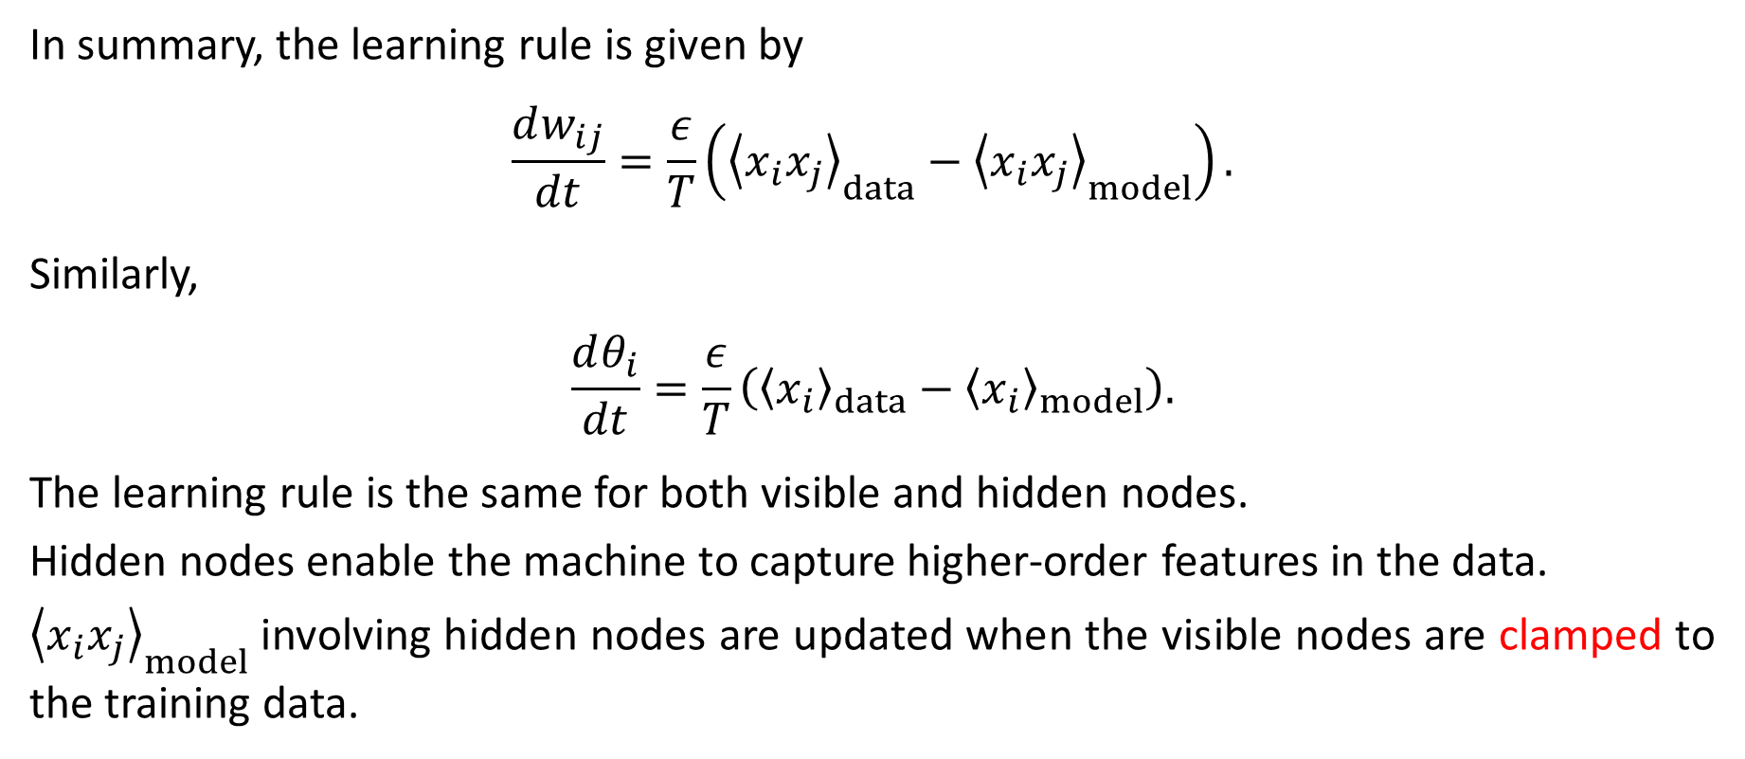
Learning in Visible and Hidden Nodes
In summary, the learning rule is given by
$$\frac{dw_{ij}}{dt}=\frac{ε}{T}\left({\left\langle x_{i}x_{j}\right\rangle }_{data}−{\left\langle x_{i}x_{j}\right\rangle }_{model}\right).$$
Similarly,
$$\frac{dθ_{i}}{dt}=\frac{ε}{T}\left({\left\langle x_{i}\right\rangle }_{data}−{\left\langle x_{i}\right\rangle }_{model}\right).$$
The learning rule is the same for both visible and hidden nodes.
Hidden nodes enable the machine to capture higher-order features in the data.
${\left\langle x_{i}x_{j}\right\rangle }_{model}$ involving hidden nodes are updated when the visible nodes are clamped to the training data.

Slide 8
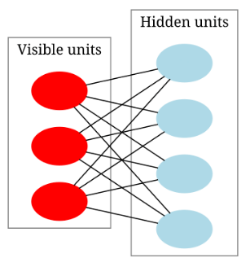
3. Restricted Boltzmann Machine²
If the visible nodes of the Boltzmann machine are only connected with the hidden nodes, and the hidden nodes only with the visible nodes, then the Boltzmann machine becomes a restricted Boltzmann machine (RBM).
In RBM, the visible nodes are not connected with each other. So are the hidden nodes.
Hence, the structure of RBM is a bipartite graph.
In feature extraction, the hidden nodes can encode the features.
When RBM’s are stacked layer by layer, they form deep belief networks, which can extract more sophisticated features. Useful for pre-training deep neural networks.
² Restricted Boltzmann machine. (28 June 2025). In Wikipedia.
https://en.wikipedia.org/wiki/Restricted_Boltzmann_machine

Slide 9
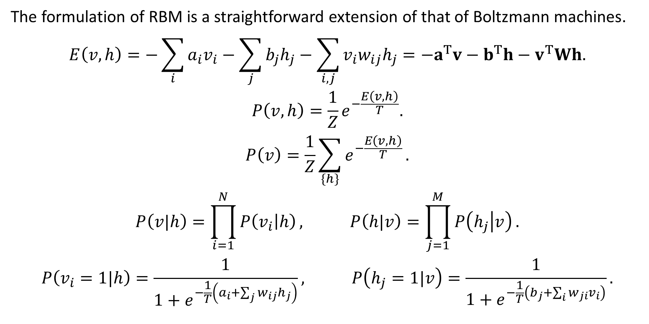
Formulation
The formulation of RBM is a straightforward extension of that of Boltzmann machines.
$$E\left(v,h\right)=−\sum_{i}{a_{i}v_{i}}−\sum_{j}{b_{j}h_{j}}−\sum_{i,j}{v_{i}w_{ij}h_{j}}=−a^{T}v−b^{T}h−v^{T}Wh.$$
$$P\left(v,h\right)=\frac{1}{Z}e^{−\frac{E\left(v,h\right)}{T}}.$$
$$P\left(v\right)=\frac{1}{Z}\sum_{\{h\}}{e^{−\frac{E\left(v,h\right)}{T}}}.$$
$$P\left(v|h\right)=\prod_{i=1}^{N}{P\left(v_{i} | h\right)}, P\left(h|v\right)=\prod_{j=1}^{M}{P\left(h_{j} | v\right)}.$$
$$P\left(v_{i}=1|h\right)=\frac{1}{1+e^{−\frac{1}{T}\left(a_{i}+\sum_{j}{w_{ij}h_{j}}\right)}}, P\left(h_{j}=1|v\right)=\frac{1}{1+e^{−\frac{1}{T}\left(b_{j}+\sum_{i}{w_{ji}v_{i}}\right)}}.$$

Slide 10
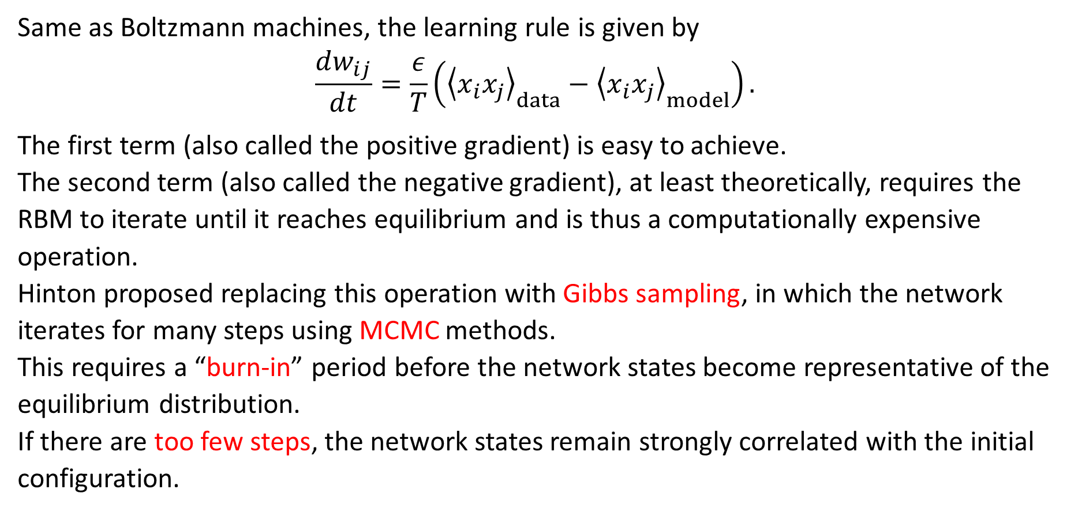
Learning Rule
Same as Boltzmann machines, the learning rule is given by
$$\frac{dw_{ij}}{dt}=\frac{ε}{T}\left({\left\langle x_{i}x_{j}\right\rangle }_{data}−{\left\langle x_{i}x_{j}\right\rangle }_{model}\right).$$
The first term (also called the positive gradient) is easy to achieve.
The second term (also called the negative gradient), at least theoretically, requires the RBM to iterate until it reaches equilibrium and is thus a computationally expensive operation.
Hinton proposed replacing this operation with Gibbs sampling, in which the network iterates for many steps using MCMC methods.
This requires a “burn-in” period before the network states become representative of the equilibrium distribution.
If there are too few steps, the network states remain strongly correlated with the initial configuration.

Slide 11
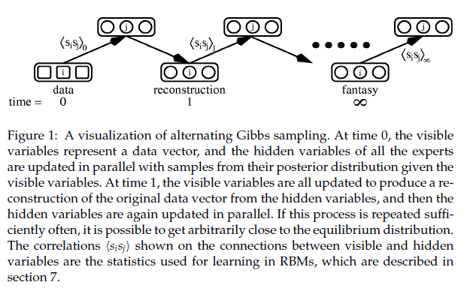
Gibbs Sampling³
³ G. E. Hinton, Training product of experts by minimizing contrastive divergence, Neural Computation 14,
1771-1800 (2002).

Slide 12
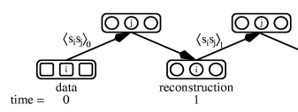

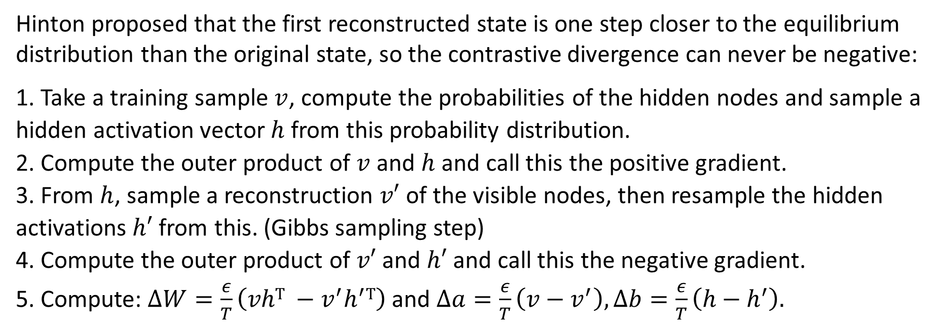



Contrastive Divergence
Hinton proposed that the first reconstructed state is one step closer to the equilibrium distribution than the original state, so the contrastive divergence can never be negative:
1. Take a training sample $v$, compute the probabilities of the hidden nodes and sample a hidden activation vector $h$ from this probability distribution.
2. Compute the outer product of $v$ and $h$ and call this the positive gradient.
3. From $h$, sample a reconstruction $v′$ of the visible nodes, then resample the hidden activations $h′$ from this. (Gibbs sampling step)
4. Compute the outer product of $v′$ and $h′$ and call this the negative gradient.
5. Compute: $ΔW=\frac{ε}{T}\left(vhT −v^{′}h^{′}T\right)$ and $Δa=\frac{ε}{T}\left(v−v^{′}\right), Δb=\frac{ε}{T}\left(h−h^{′}\right).$
$$h$$
$$h′$$
$$v$$
$$v′$$

Slide 13
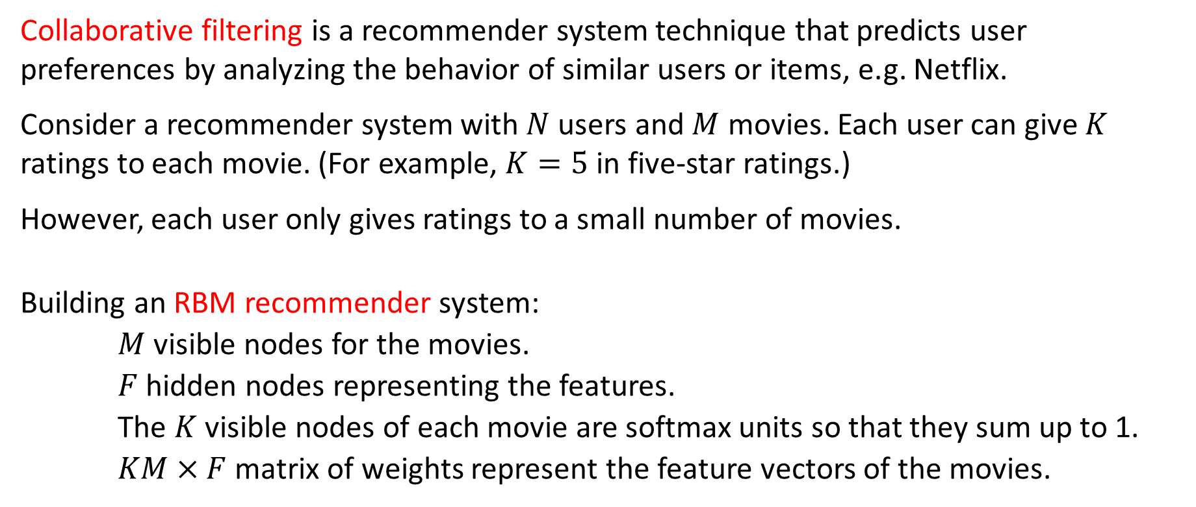
4. RBM Recommender System⁴
Collaborative filtering is a recommender system technique that predicts user preferences by analyzing the behavior of similar users or items, e.g. Netflix.
Consider a recommender system with $N$ users and $M$ movies. Each user can give $K$ ratings to each movie. (For example, $K=5$ in five-star ratings.)
However, each user only gives ratings to a small number of movies.
Building an RBM recommender system:
$M$ visible nodes for the movies.
$F$ hidden nodes representing the features.
The $K$ visible nodes of each movie are softmax units so that they sum up to 1.
$KM×F$ matrix of weights represent the feature vectors of the movies.
³ R. Salakhudinov, A. Mnih, G. Hinton, Restricted Boltzmann Machines for Collaborative Filtering, Proceedings of the 24th International Conference on Machine learning - ICML ‘07, 791 (2007).

Slide 14
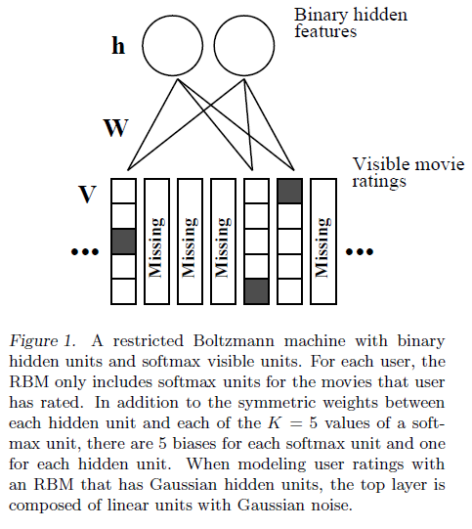
Missing Ratings

Slide 15
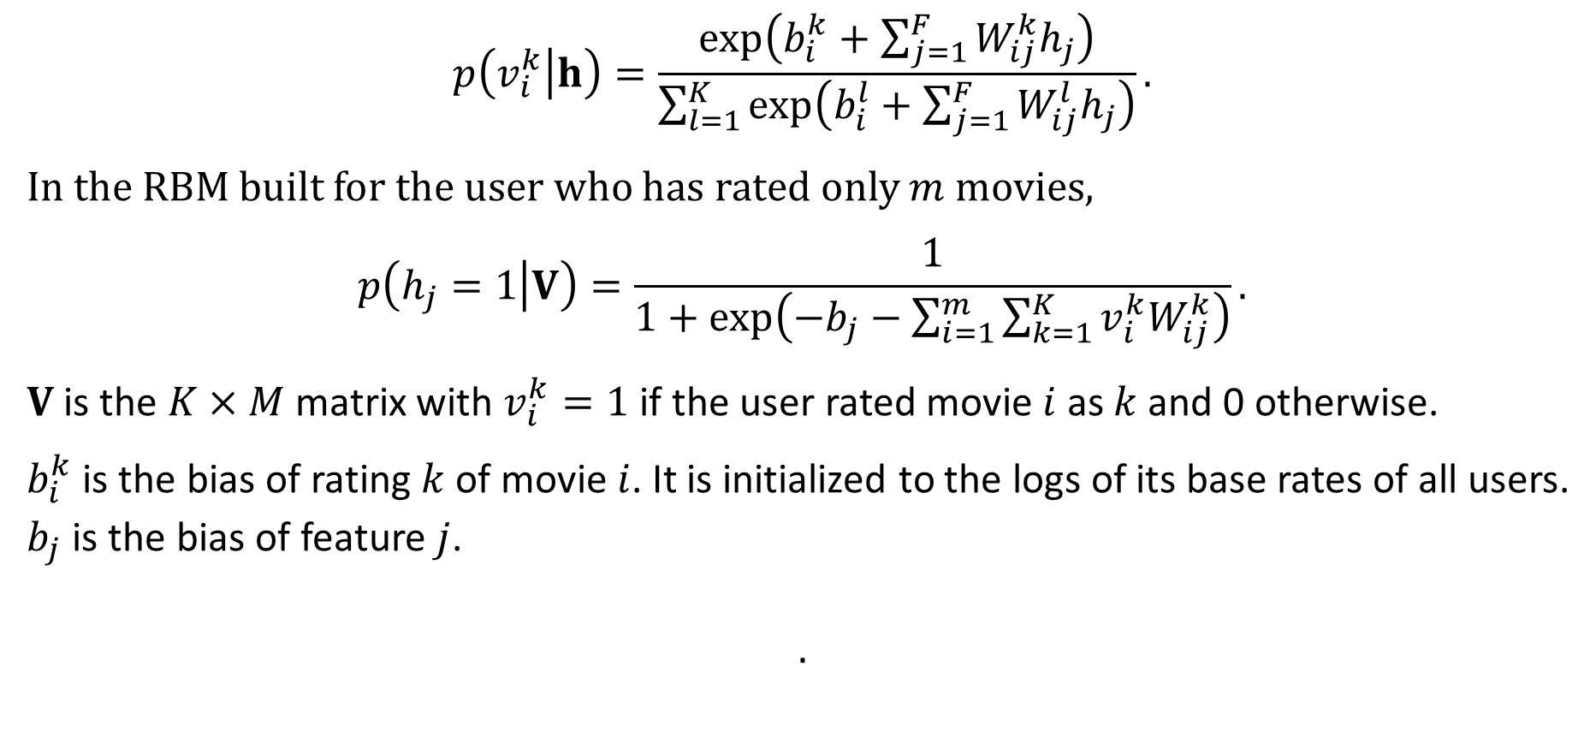
Formulation (1)
$$p\left(v_{i}^{k} | h\right)=\frac{\exp\left(b_{i}^{k}+\sum_{j=1}^{F}{W_{ij}^{k}h_{j}}\right)}{\sum_{l=1}^{K}{\exp\left(b_{i}^{l}+\sum_{j=1}^{F}{W_{ij}^{l}h_{j}}\right)}}.$$
In the RBM built for the user who has rated only $m$ movies,
$$p\left(h_{j}=1 | V\right)=\frac{1}{1+\exp\left(−b_{j}−\sum_{i=1}^{m}{\sum_{k=1}^{K}{v_{i}^{k}W_{ij}^{k}}}\right)}.$$
$V$ is the $K×M$ matrix with $v_{i}^{k}=1$ if the user rated movie $i$ as $k$ and 0 otherwise.
$b_{i}^{k}$ is the bias of rating $k$ of movie $i$. It is initialized to the logs of its base rates of all users.
$b_{j}$ is the bias of feature $j$.
$$.$$

Slide 16
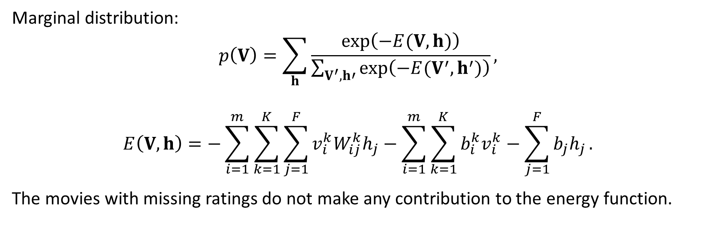
Formulation (2)
Marginal distribution:
$$p\left(V\right)=\sum_{h}{\frac{\exp\left(−E(V,h)\right)}{\sum_{V^{′},h′}{\exp\left(−E(V^{′},h^{′})\right)}}},$$
$$E\left(V,h\right)=−\sum_{i=1}^{m}{\sum_{k=1}^{K}{\sum_{j=1}^{F}{{v_{i}^{k}W}_{ij}^{k}h_{j}}}}−\sum_{i=1}^{m}{\sum_{k=1}^{K}{b_{i}^{k}v_{i}^{k}}}−\sum_{j=1}^{F}{b_{j}h_{j}}.$$
The movies with missing ratings do not make any contribution to the energy function.

Slide 17
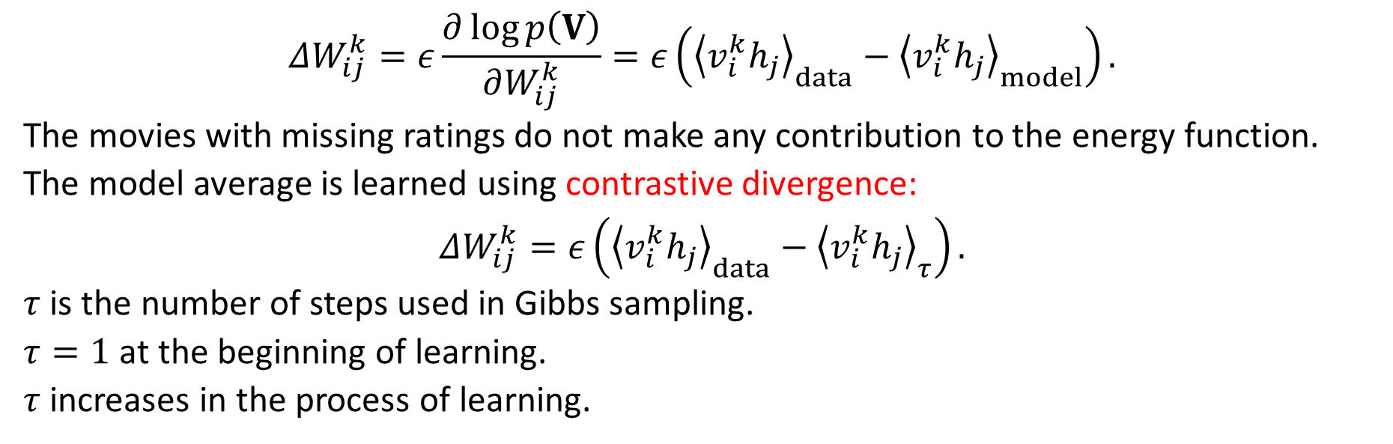
Learning
$$ΔW_{ij}^{k}=ε\frac{∂\log{p\left(V\right)}}{∂W_{ij}^{k}}=ε\left({\left\langle v_{i}^{k}h_{j}\right\rangle }_{data}−{\left\langle v_{i}^{k}h_{j}\right\rangle }_{model}\right).$$
The movies with missing ratings do not make any contribution to the energy function.
The model average is learned using contrastive divergence:
$$ΔW_{ij}^{k}=ε\left({\left\langle v_{i}^{k}h_{j}\right\rangle }_{data}−{\left\langle v_{i}^{k}h_{j}\right\rangle }_{τ}\right).$$
$τ$ is the number of steps used in Gibbs sampling.
$τ=1$ at the beginning of learning.
$τ$ increases in the process of learning.

Slide 18
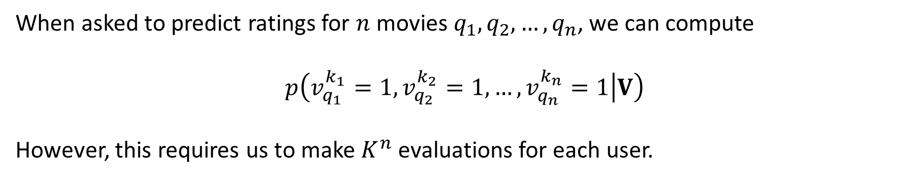
Making Predictions (1)
When asked to predict ratings for $n$ movies $q_{1}, q_{2},…, q_{n}$, we can compute
$$p\left(v_{q_{1}}^{k_{1}}=1,v_{q_{2}}^{k_{2}}=1,…,v_{q_{n}}^{k_{n}}=1 | V\right)$$
However, this requires us to make $K^{n}$ evaluations for each user.

Slide 19
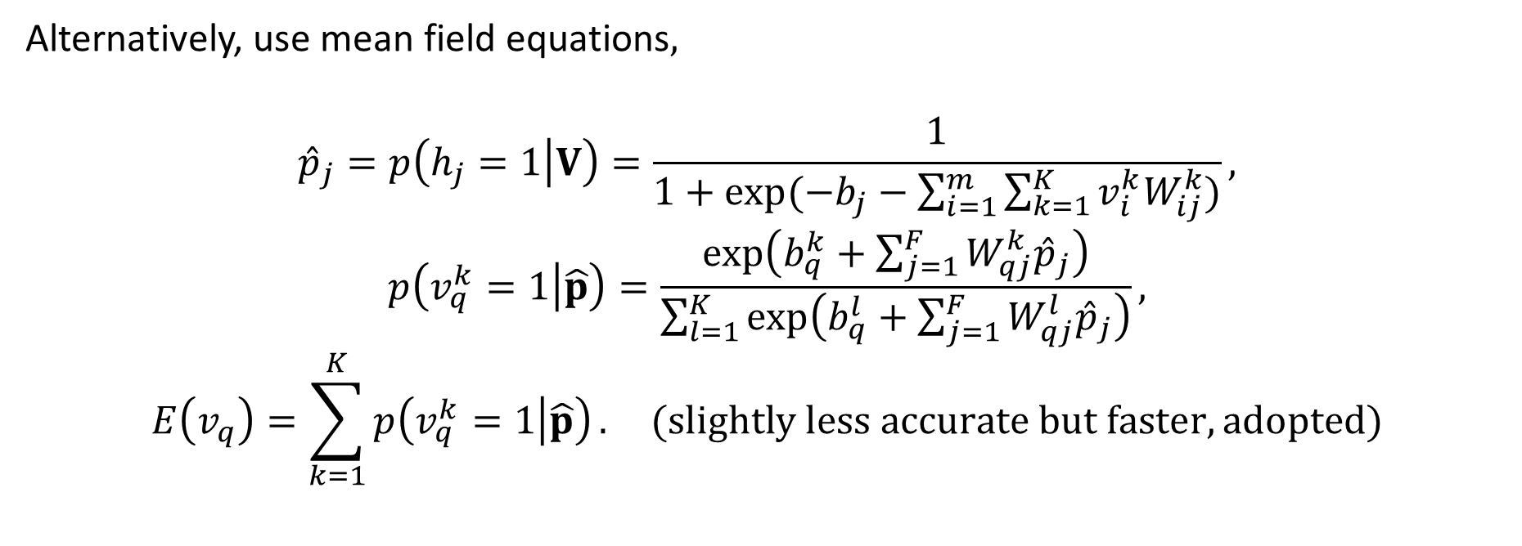
Making Predictions (2)
Alternatively, use mean field equations$,$
$${\hat{p}}_{j}=p\left(h_{j}=1 | V\right)=\frac{1}{1+\exp{(−b_{j}−\sum_{i=1}^{m}{\sum_{k=1}^{K}{v_{i}^{k}W_{ij}^{k}}}})},$$
$$p\left(v_{q}^{k}=1 | \hat{p}\right)=\frac{\exp\left(b_{q}^{k}+\sum_{j=1}^{F}{W_{qj}^{k}{\hat{p}}_{j}}\right)}{\sum_{l=1}^{K}{\exp\left(b_{q}^{l}+\sum_{j=1}^{F}{W_{qj}^{l}{\hat{p}}_{j}}\right)}},$$
$$E\left(v_{q}\right)=\sum_{k=1}^{K}{p\left(v_{q}^{k}=1 | \hat{p}\right)}. (slightly less accurate but faster, adopted)$$

Slide 20
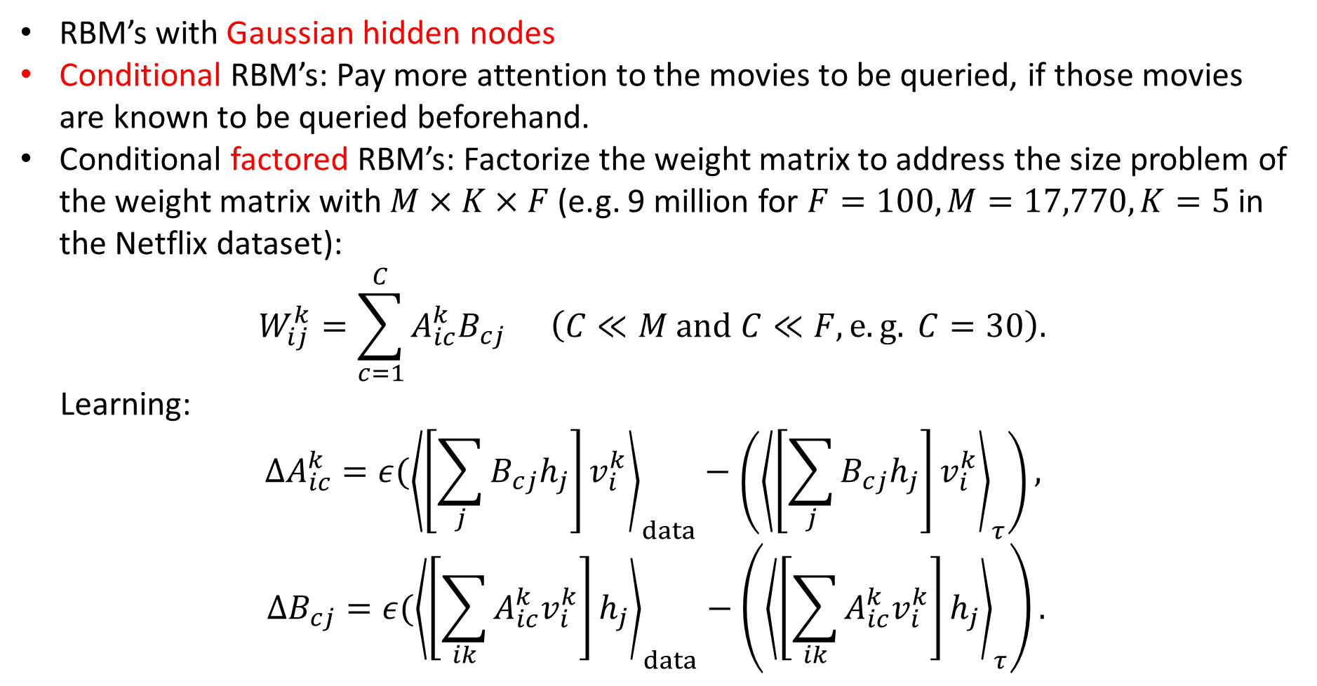
Further Details
RBM’s with Gaussian hidden nodes
Conditional RBM’s: Pay more attention to the movies to be queried, if those movies are known to be queried beforehand.
Conditional factored RBM’s: Factorize the weight matrix to address the size problem of the weight matrix with $M×K×F$ (e.g. 9 million for $F=100, M=17,770, K=5$ in the Netflix dataset):
$$W_{ij}^{k}=\sum_{c=1}^{C}{A_{ic}^{k}B_{cj}} \left(C≪M and C≪F, e.g. C=30\right).$$
Learning:
$$ΔA_{ic}^{k}=ε({\left\langle \left[\sum_{j}{B_{cj}h_{j}}\right]v_{i}^{k}\right\rangle }_{data}−\left({\left\langle \left[\sum_{j}{B_{cj}h_{j}}\right]v_{i}^{k}\right\rangle }_{τ}\right),$$
$$ΔB_{cj}=ε({\left\langle \left[\sum_{ik}{A_{ic}^{k}v_{i}^{k}}\right]h_{j}\right\rangle }_{data}−\left({\left\langle \left[\sum_{ik}{A_{ic}^{k}v_{i}^{k}}\right]h_{j}\right\rangle }_{τ}\right).$$

Slide 21
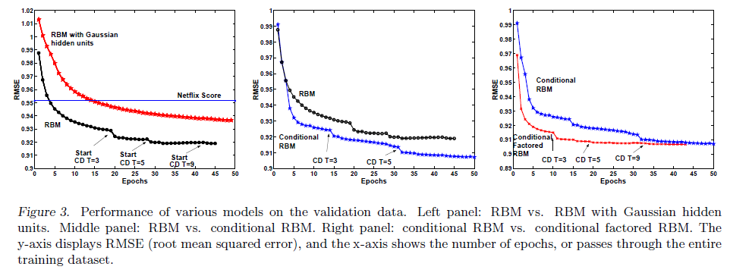
Experimental Results

